Slide 1
Challenges of Nation-wide Scaling up and Sustainability
Dr. Kamal Kar
Chairman CLTS Foundation
Institute of Development Studies
Brighton, UK
June 11th, 2015

Slide 2
MDG and CLTS in Africa
CLTS was introduced in Africa in 2007
  First in Eastern and Southern Africa (Tanzania, Ethiopia Zambia, Kenya)
  Later in Western and Central Africa ( Sierra Leone, Liberia, Mali, Chad, Ghana, Nigeria)
Competition amongst the countries and organizations in a country in achieving more of ODF villages
  Initially Ethiopia, Kenya, Malawi, Sierra Leone and others did very well

Slide 3
MDG and CLTS in Africa
Institutionalization and scaling up became more challenging than introduction
  From a few hundred ODF villages to ODF districts, ODF regions and ODF nation demanded involvement of another set of actors, triggering and advocacy at a different level
Community’s success on CLTS established and reemphasized that without collective behaviour change improvement in sanitation was not possible. This challenged the national level policy and decision makers who believed in top-down, prescriptive and subsidized/free toilet construction

Slide 4
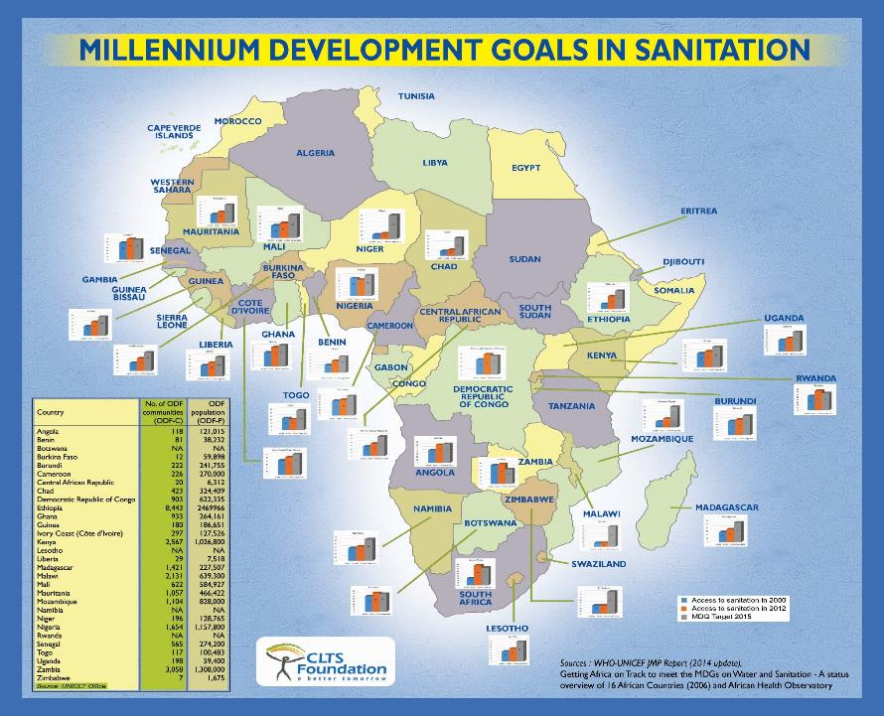

Slide 5
Challenges
Governments used to subsidy driven approach resisted making the policy shift towards community empowerment
  Without policy and a nation wide strategy with roadmap and adequate resources, institutionalisation and large-scale scaling up was not possible
Mandate for sanitation/WASH rested with ministries focused on infrastructure creation rather than measuring health outcomes
  Focus on toilet construction continued

Slide 6
Challenges
While some nations realized the need for behaviour change for sustained health outcomes, changing the mind-set of some donors to modify funding guidelines posed a new challenge
Weak inter and intra-institutional coordination and lack of functional linkages between organisations and departments blocked effective convergence of efforts.

Slide 7
Innovative scaling up strategies
Sanitation led by Ministry of Health/Public Health focusing on health outcomes rather than infrastructure creation
  Kenya, Ethiopia, Indonesia
Clear national sanitation strategy with ODF target and roadmap
  Achieved ODF communes, sub-districts, districts
  Successfully created a healthy competition amongst the local governments within the country which triggered national ODF campaign. E.g. Madagascar, Kenya

Slide 8
Innovative scaling up strategies
Transforming mindsets of donor agencies
  Countries like Ghana (WB), Chad (EU) succeeded in transforming major donor’s funding mechanism and terms as decided by the country themselves rather than the outsiders

Slide 9
Innovative scaling up strategies
Emergence of CLTS champions at highest leadership level
  As the success of communities attracted the attention of local government, the national level political leadership became interested to show case the success at the country level and emerge as champion at the region. E.g. Malawi, Madagascar, Zambia

Slide 10
Innovative scaling up strategies
Establishing appropriate enabling environment helped in converging the efforts of multiple actors towards realizing the national goal rather than disconnected and piecemeal success on CLTS

Slide 11
Innovative scaling up strategies
  Need for abolishing the practice of OD is being stressed by set of new champions emerged at the highest levels of national political leadership ( President, Prime Minister of Madagascar, Timor Leste, Kiribati, Ministers of Ghana, Cote De Ivory, Malawi, Kenya, etc.)
Established organic scaling-up mechanisms
  Widening network with Natural leaders and Community Consultants

Slide 12
Innovative scaling up strategies
Innovative funding mechanisms
Emergence of new financing mechanisms like GSF

Slide 13

Attitude and Behavior Change
Personal
Professional
Institutional
Policy Context
Enabling Environment
CLTS Tools and Techniques
Pre-triggering
Essential Convergence
Inter-Institutional Coordination
Triggering
Post Triggering Follow-up
National Protocol/ Budget
Post ODF actions

Slide 14
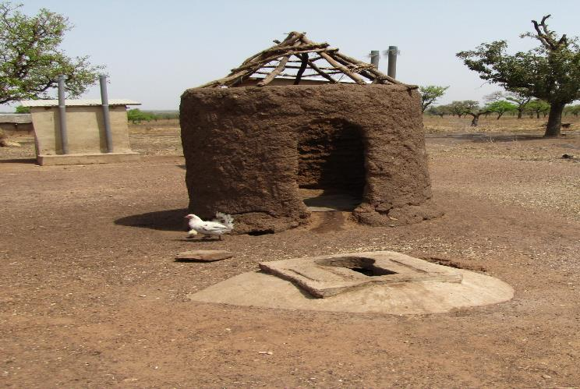
Can we ensure a better coordination than
this? Institutional OD?

Slide 15
Honourable Mr. Elvis Afriya, Minister of Sports and Youth Affairs, Ghana (front row ;c entre)
His Excellency Mr.Hery Rajaonarimampianina, President,Madagascar(4th from left)
Honourable Mr. Roger Kolo,Prime Minister of Madagascar(on right)
His Excellency Mr.Anote Tong,President, Kiribati(2nd from left)
Honourable Mr.Fernando Lasama De Araujo,Vice Prime Minister, Timor Leste

Slide 16
How do we approach the SDGs?
What can we lean from the successes of countries that have done well?
What lessons can we apply to address the newly emerging challenges ?
How do we scale up CLTS with quality in the next ten years?
How can countries in Africa support each other?

Slide 17
Thank You!

